Slide 1
PROJECTIONS OF SOLIDS

Slide 2
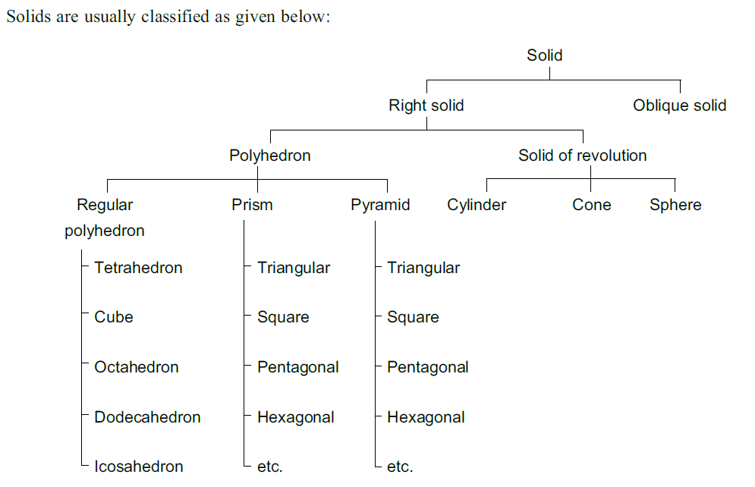
CLASSIFICATION OF SOLIDS

Slide 3
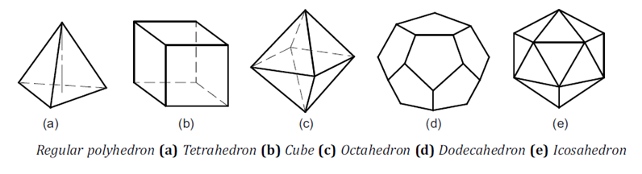
CLASSIFICATION OF SOLIDS
Polyhedron
A polyhedron is a solid bounded by planes called faces, which meet in straight lines called edges. A regular polyhedron has all the faces equal and regular as shown in Fig..

Slide 4
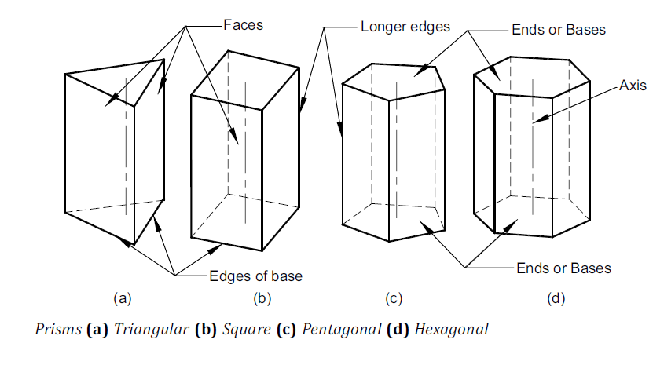
CLASSIFICATION OF SOLIDS
Prism
A prism is a polyhedron with two n-sided polygonal bases which are parallel and congruent, and lateral faces are rectangles. All cross-sections parallel to the bases are congruent with the bases. An imaginary line that joins the centre of the bases is called an axis. A right and regular prism has regular polygonal bases, axis perpendicular to the bases and all the faces are equal rectangles, as shown in Fig.

Slide 5
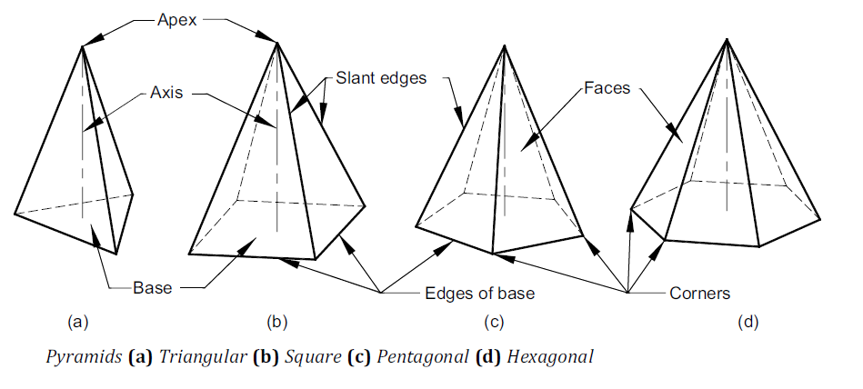
CLASSIFICATION OF SOLIDS
Pyramid
A pyramid is a polyhedron with n-sided polygonal base and lateral faces are triangles meeting at a point called the vertex or apex. An imaginary line that joins the apex with the centre of the base is known as the axis. A right and regular pyramid has a regular polygon base, axis perpendicular to the base and all the faces are equal isosceles triangles, as shown in Fig.

Slide 6
CLASSIFICATION OF SOLIDS
Solid of Revolution
These solids are obtained by revolving a plane figure like rectangle, triangle or a semi-circle about a fixed line.
1. Cylinder A cylinder is a solid of revolution obtained by revolving a rectangle about one of its fixed side called an axis. It can be imagined as a prism of infinite number of lateral faces. Any line on the surface of a cylinder is called its generator. Thus, a cylinder has an infinite number of generators. A right cylinder has all the generators and the axis perpendicular to the base, as shown in Fig. (a).
2. Cone A cone is obtained by revolving a triangle about its fixed side called an axis. A cone can be imagined as a pyramid with infinite number of lateral faces. Any line on the surface of a cone is called its generator. Thus, a cone has an infinite number of generators. A right cone has all generators of equal length and the axis perpendicular to the base, as shown in Fig. (b).
3. Sphere A sphere is obtained by revolving a semi-circle around its diameter, as shown in Fig.(c)

Slide 7
CLASSIFICATION OF SOLIDS
Solid of Revolution
These solids are obtained by revolving a plane figure like rectangle, triangle or a semi-circle about a fixed line.
1. Cylinder A cylinder is a solid of revolution obtained by revolving a rectangle about one of its fixed side called an axis. It can be imagined as a prism of infinite number of lateral faces. Any line on the surface of a cylinder is called its generator. Thus, a cylinder has an infinite number of generators. A right cylinder has all the generators and the axis perpendicular to the base, as shown in Fig. (a).
2. Cone A cone is obtained by revolving a triangle about its fixed side called an axis. A cone can be imagined as a pyramid with infinite number of lateral faces. Any line on the surface of a cone is called its generator. Thus, a cone has an infinite number of generators. A right cone has all generators of equal length and the axis perpendicular to the base, as shown in Fig. (b).
3. Sphere A sphere is obtained by revolving a semi-circle around its diameter, as shown in Fig.(c)

Slide 8
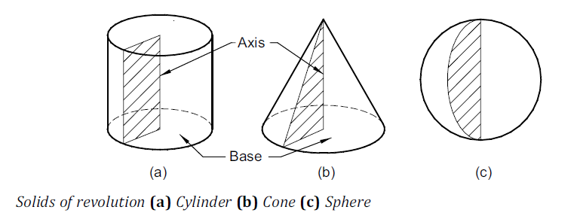
CLASSIFICATION OF SOLIDS

Slide 9
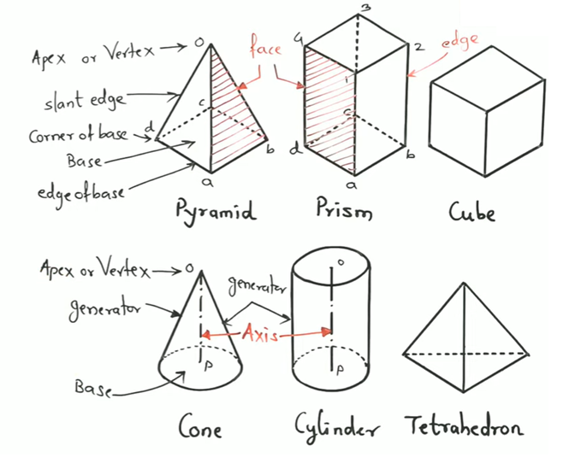

Slide 10
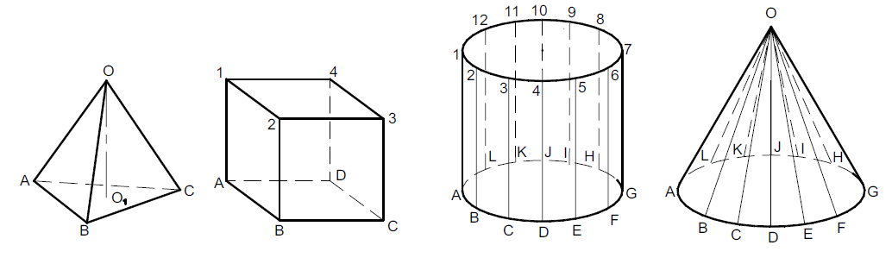
RECOMMENDED METHOD OF LABELING

Slide 11
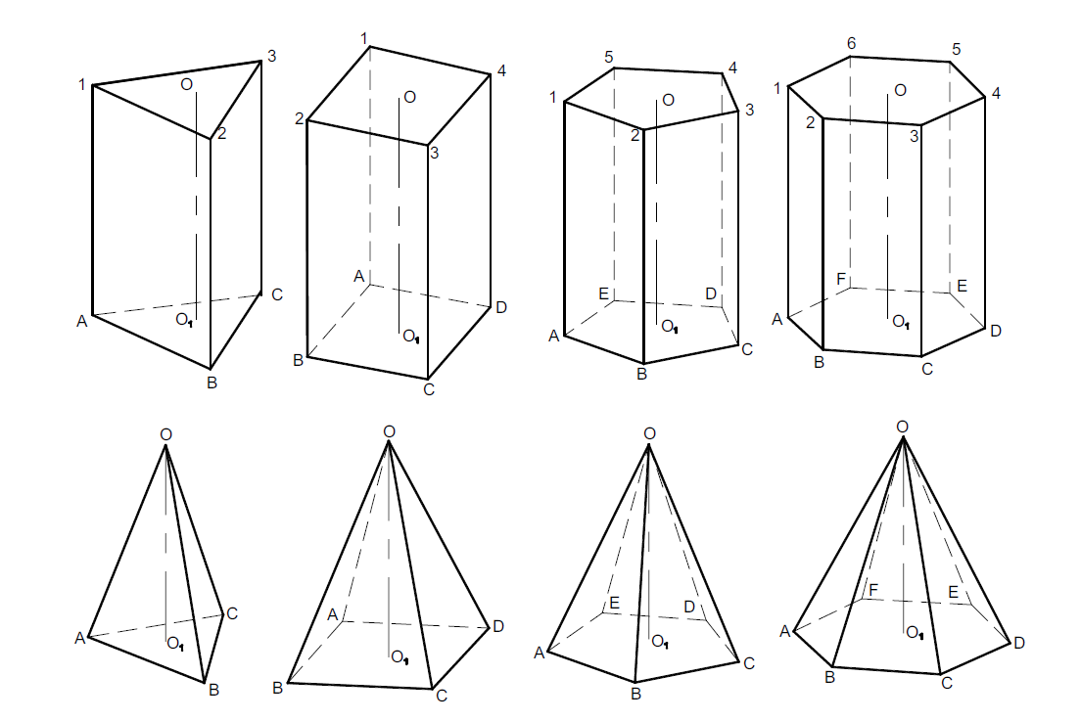
RECOMMENDED METHOD OF LABELING

Slide 12
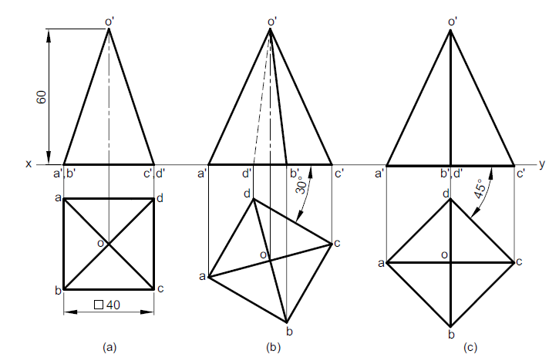
AXIS PERPENDICULAR TO H.P
1. A square pyramid of base side 40 mm and axis 60 mm is resting on its base on the H.P. Draw its projections when (a) a side of the base is parallel to the V.P., (b) a side of the base is inclined at 30° to the V.P., (c) all the sides of the base are equally inclined to the V.P.

Slide 13
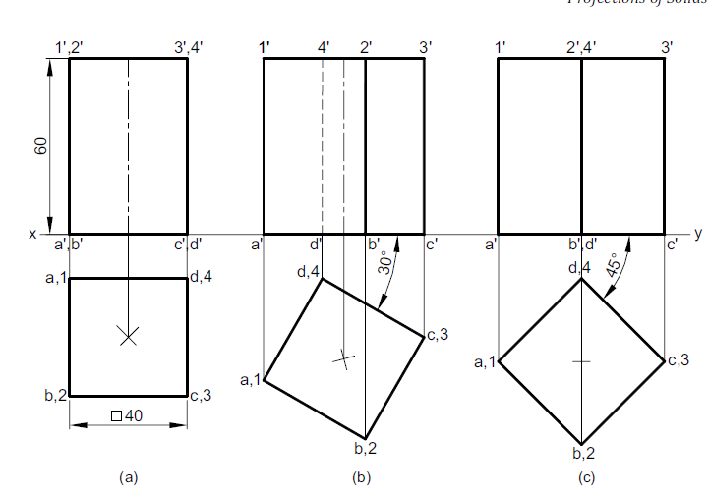
AXIS PERPENDICULAR TO H.P
2. A square prism of base side 40 mm and axis 60 mm is resting on its base on the ground. Draw its projections when (a) a face is perpendicular to the V.P., (b) a face is inclined at 30° to the V.P., (c) all the faces are equally inclined to the V.P.

Slide 14
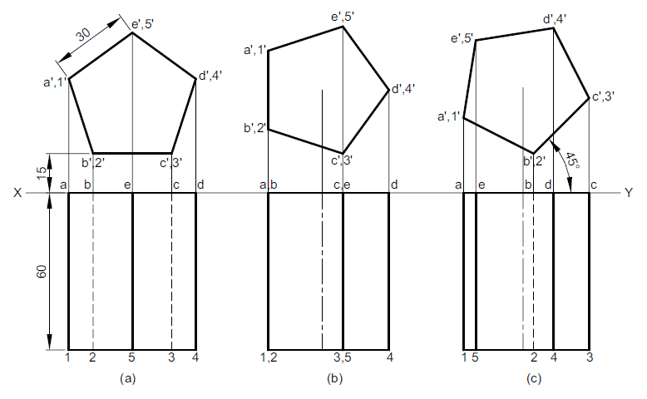
AXIS PERPENDICULAR TO V.P
3. A pentagonal prism of base side 30 mm and axis 60 mm has one of its bases in the V.P. Draw its projections when (a) a rectangular face is parallel to and 15 mm above the H.P., (b) a face is perpendicular to the H.P., (c) a face is inclined at 45° to the H.P.

Slide 15
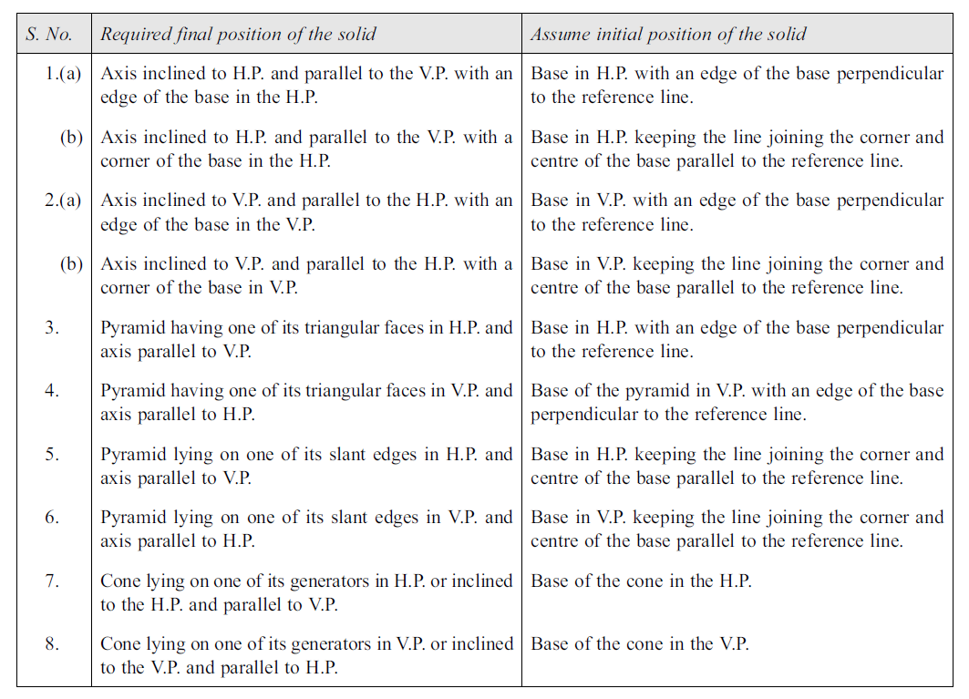
INITIAL POSITION OF THE SOLID – GENERAL RULES

Slide 16
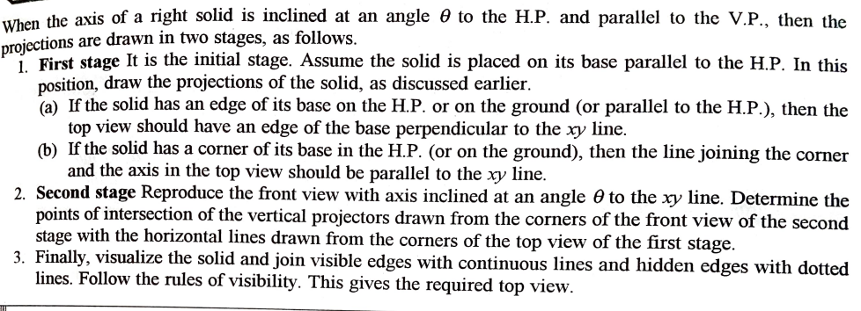
AXIS INCLINED TO H.P. AND PARALLEL TO V.P.

Slide 17
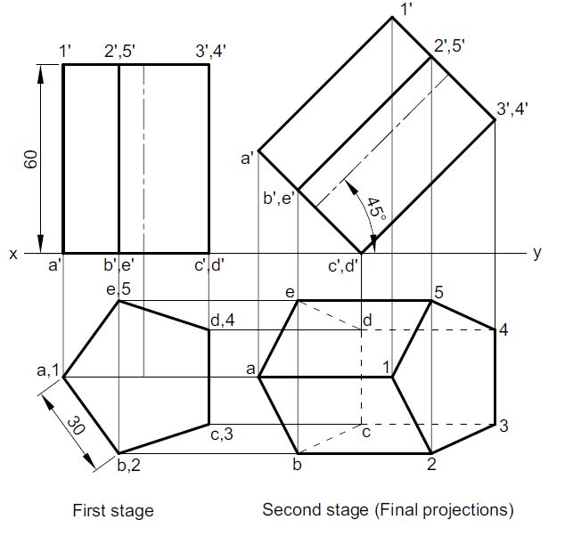
AXIS INCLINED TO H.P. AND PARALLEL TO V.P.
4. A pentagonal prism of base edge 30 mm and axis 60 mm rests on an edge of its base in the H.P. Its axis is parallel to V.P. and inclined at 45° to the H.P. Draw its projections.

Slide 18
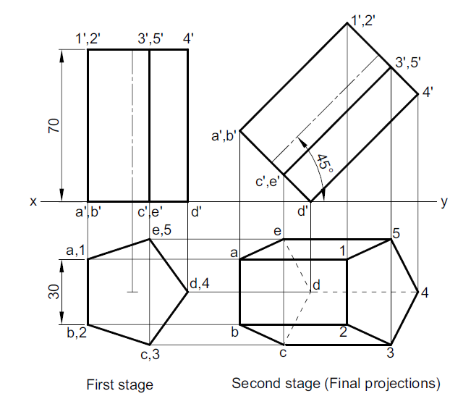
AXIS INCLINED TO H.P. AND PARALLEL TO V.P.
5. A pentagonal prism of base side 30 mm and axis 70 mm has a corners on the H.P. and the axis is inclined at 45° to the H.P. Draw its projection when the plane containing the resting corner and the axis is parallel to the V.P.

Slide 19
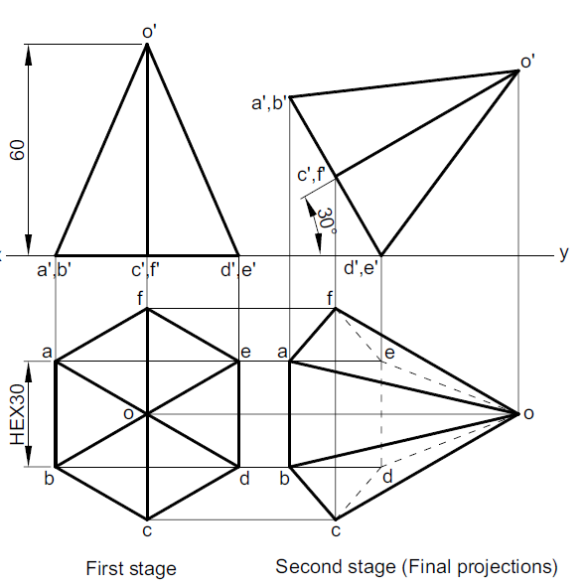
AXIS INCLINED TO H.P. AND PARALLEL TO V.P.
6. A hexagonal pyramid of base side 30 mm and axis 60 mm has an edge of its base on the ground. Its axis is inclined at 30° to the ground and parallel to the V.P. Draw its projections.

Slide 20
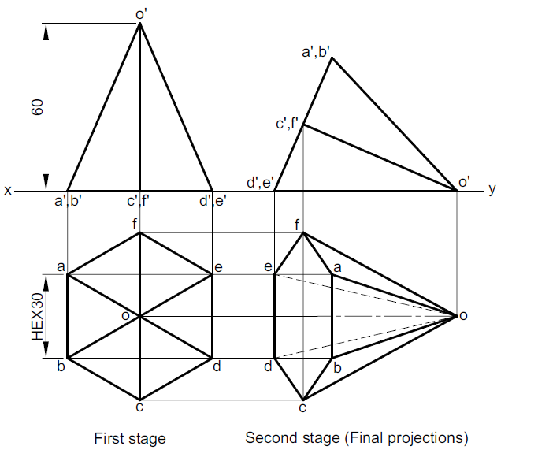
AXIS INCLINED TO H.P. AND PARALLEL TO V.P.
7. A hexagonal pyramid of base edge 30 mm and axis 60 mm, has a triangular face
on the ground and the axis parallel to the V.P. Draw its projections.

Slide 21
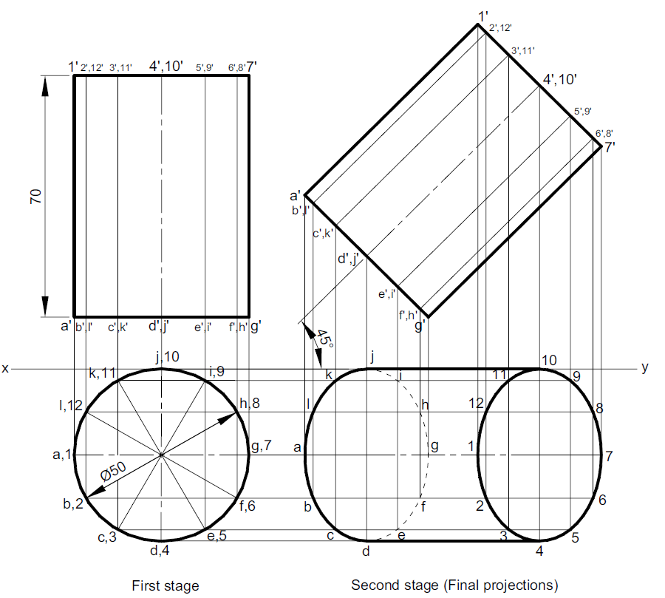
AXIS INCLINED TO H.P. AND PARALLEL TO V.P.
8. A cylinder of base diameter 50 mm and axis 70 mm has a generator in the V.P. and inclined at 45° to the H.P. Draw its projections.

Slide 22
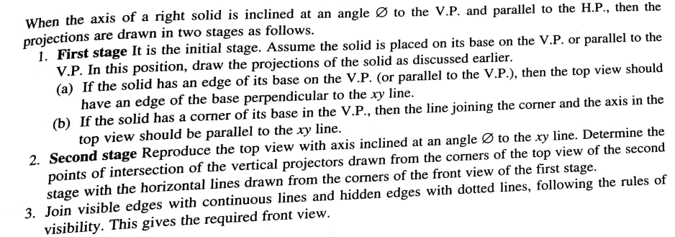
AXIS INCLINED TO V.P. AND PARALLEL TO H.P.

Slide 23
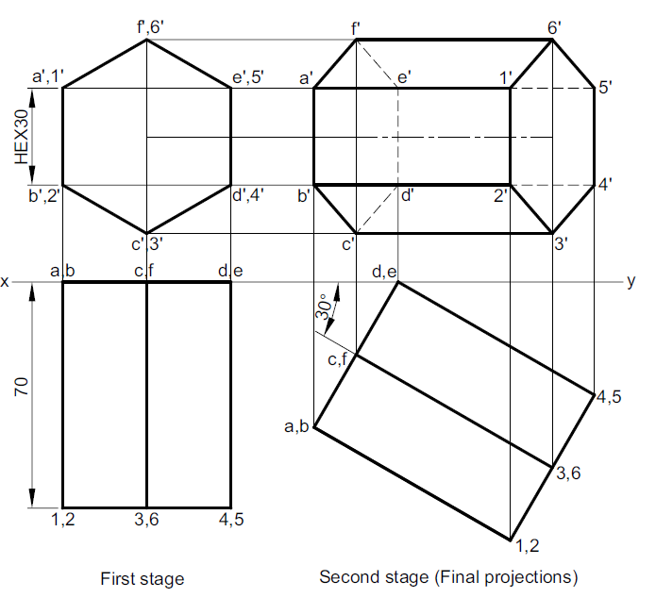
AXIS INCLINED TO V.P. AND PARALLEL TO H.P.
9. A hexagonal prism of base edge 30 mm and axis 70 mm has an edge of its base
in the V.P. such that the axis is inclined at 30° to the V.P. and parallel to the H.P. Draw its projections.

Slide 24
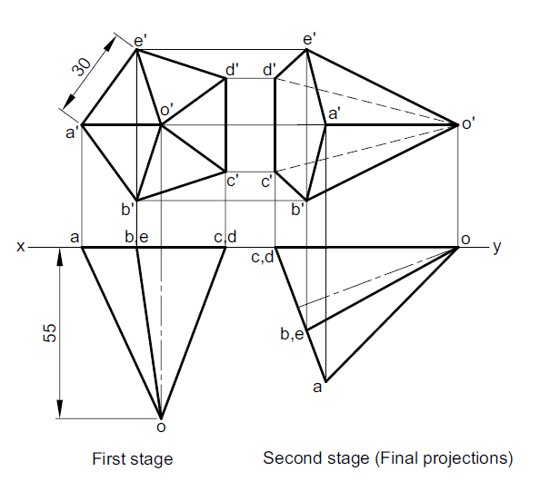
AXIS INCLINED TO V.P. AND PARALLEL TO H.P.
10. A pentagonal pyramid of base side 30 mm and axis 55 mm has a triangular face in the V.P. and the base edge contained by that triangular face is perpendicular to the H.P. Draw its projections.

Slide 25
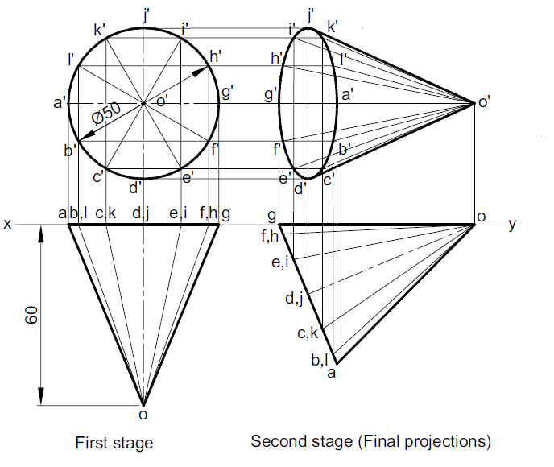
AXIS INCLINED TO V.P. AND PARALLEL TO H.P.
11. A cone of base diameter 50 mm and axis 60 mm has a generator in the V.P. and the axis parallel to the H.P. Draw its projections.

Slide 26
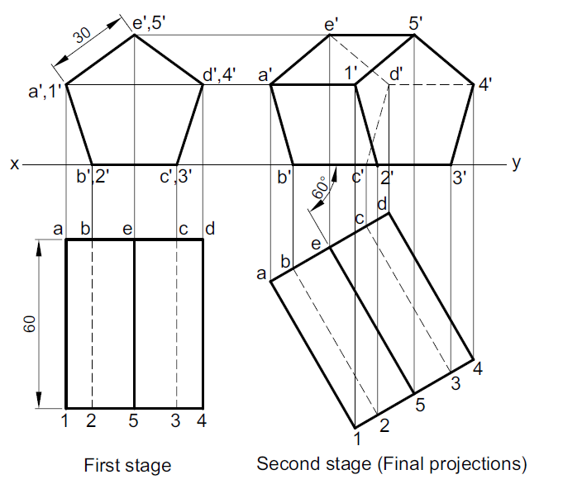
AXIS INCLINED TO V.P. AND PARALLEL TO H.P.
12. A pentagonal prism of base side 30 mm and axis 60 mm has one of its rectangular faces on the H.P. and the axis inclined at 60° to the V.P. Draw its projections.

